Slide 1
Presentation Hoover Library
From Wood to Brass: Evolution of Early American Clock Making
July 13, 2024
Richard Littleton

Slide 2
Area of Interest
Evolution of American movements from wood to brass- Introduction and Resources
National Association of Watch and Clock Collectors (NAWCC),
historical accounts, and
online sources including the Autobiography of Chauncy Jerome
Notes:
An area of interest I would like to share with you today is a small part of my research on early American clock making. Specifically, the evolution from wood movements to brass movements. Much of the research comes from sources associated with the National Association of Watch and Clock Collectors (NAWCC), historical accounts, and online sources including the Autobiography of Chauncy Jerome.

Slide 3
Why were most early American clocks wood movements?
Complicated yet common sense reasons
Manufacturing and technology were not commonplace in America
Abundant natural resources, especially land, water, and forests
Lack of businesses like foundries and copper mines
Control of commerce and manufacturing by British and French governments
Imports like springs and brass were hard to get and expensive
Notes:
When I began to research American clock making, I was puzzled as to why most early American clock movements were made from wood rather than metal. Wood was also the material of choice for American clock dials and cases. Many European makers were producing movements as early as the 1600’s and 1700’s from rolled and cast brass. European makers, especially in France, had been producing steel springs allowing for smaller cases that eliminated the need for weights and increase the run time from one day to eight or more days. Smaller cases could also be made from metal or stone. What I discovered was a complicated yet common sense approach to clock making and manufacturing in general.

Slide 4
The worldwide industrial revolution spurs change
farms began to be replaced by great cities
Falling water and steam soon was soon powering manufacturing on an industrial scale
Individual craftsmen and women working from home were replaced by vast factories employing many workers
manufacturing and commerce became part of the fabric of the country
Products wanted by the masses were affordable and available
Notes:
The industrial revolution that began in Europe soon spread to the colonies. In the Northeast and along the vast waterways of the interior, farms began to be replaced by great cities. Falling water and steam soon was soon powering manufacturing on an industrial scale. Individual craftsmen and women working from home were replaced by vast factories employing many workers. By the end of the American Revolution, manufacturing and commerce were part of the fabric of the country.

Slide 5
Eli Terry (1772-1852) Connecticut Clockmaker
Considered the father of mass-produced clock making in the United States
Plymouth Hollow, Conn
apprentice at age 14
first business (1793) was the first water powered clock factory in the US
locally sourced materials and labor
sons Eli, Jr. and Henry carried on the family business
The Porter contract
Silas Hoadley (1786-1870), Seth Thomas (1785-1859), Chauncy Jerome (1793-1868)
Notes:
Enter Eli Terry (1772-1852) Connecticut Clockmaker, the father of mass-produced clock making in the United States (US). While Connecticut was not the only area of the new world where clock making occurred, here I focus on a group of makers instrumental in putting clock making in America on the proverbial map. Eli Terry began making clocks as an apprentice at age 14 to one Daniel Burnap in Watertown, Connecticut. Terry’s first business (1793) was the first water powered clock factory in the US located on a stream behind his new home in an area of Watertown which later became known as Plymouth. Using locally sourced materials and labor, he made wooden clocks and peddled them in the general area around Watertown and Bristol. His two sons Eli, Jr. and Henry later carried on the family business.
In 1807, Terry contracted with Edward and Levi Porter to make 4,000 clocks in three years. The idea was scoffed at by others in the business as foolish and impossible. Wooden clocks could take a skilled craftsman months to complete. Terry hired Silas Hoadley (1786-1870) and Seth Thomas (1785-1859), to operate his new water powered factory at the site of an old grist mill in Plymouth. They spent the first year building the factory, machinery, sourcing materials, and training the labor from the surrounding area. The second year they produced 1,000 clocks and the rest is history. After finishing the contract, Terry sold his factory in Plymouth to Thomas and Hoadley. Terry didn’t stop making and working for other makers. Terry started a company with his sons in 1823 (Eli Terry and Sons). He and his heirs continued to invent, patent, and sell clocks for many years.

Slide 6
Brass Movement
Mid 1930s the wood movement was out and the brass movement was in
Brass strap movement- the A frame
Introduction of spring driven clocks made smaller, lighter, more run time
More modern clocks, massed produced, dependable, affordable
Most are now made in Germany or Asia
Introduction of the electric and later the quartz
Atomic clocks and accuracy of early clocks and your cell phone
Notes:
During the 17th and 18th centuries, much of the technologies for making brass and spring steel didn’t exist. During the 19th century, American companies were created to mine and process raw materials that were then supplied to other companies that manufactured finished products at affordable prices. These products became commonplace in American homes. Patents were filed in the US Patent office in such great numbers that it was said that officials from the government stated the patent office might as well be closed as everything that could be invented was already invented. That was in the 19th Century!
Enter the brass movement and spring driven clock. By the middle of the 1830s, brass and steel had replaced wood as the material of choice to mass produce American clock movements. Businessmen such as Anson Phelps (later formed the Ansonia Clock Company) were producing brass in their foundries in huge quantities. With a need to find a way to sell their brass, some turned to experts like those described above to invent movements that would be easier (and cheaper) to make from brass. Rolled brass was a relatively new product. However, the technology and machinery to accurately stamp out the plates, bushings, and wheels was not perfected at first. Straps of brass could be riveted together, and mass produced into movements. The most well know “strap” brass movement was a design know as the “A frame.” Sturdy and simple, it was commonly used in what was known as “Tripple Decker” cases. These were large wood cased clocks powered by heavy weights. They could be placed on a fireplace hearth, shelf, or mantle. The picture below shows an A frame from a company with the trademark B. M. & Co. I have one! In 1837, Birge, Mallory & Co. (B. M. & Co.) was formed by John Birge and Ransom Mallory. B. M. & Co. was known for their triple-decker shelf clocks and produced 8-day and 30-hour brass movement shelf clocks through 1843.

Slide 7
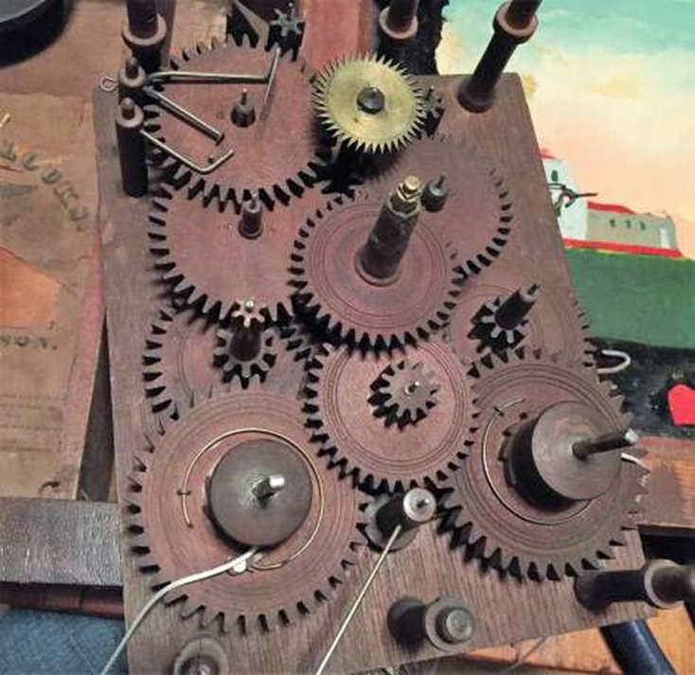
Early Terry wood movement circa 1807

Slide 8
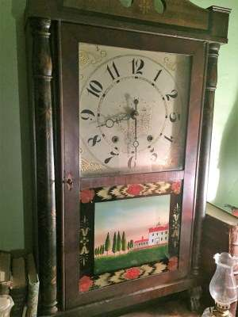
Original Terry Patented Pillar and Scroll circa 1815

Slide 9
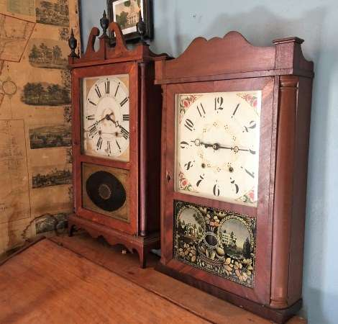
Original Terry Pillar and Scroll and Collum and Splat circa 1820

Slide 10
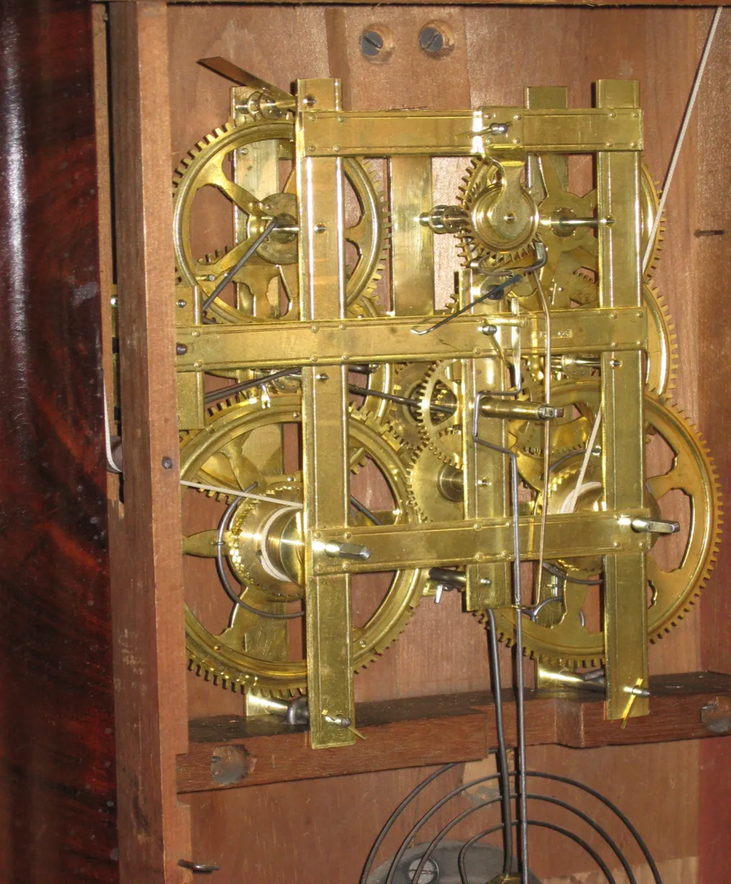
B. M. & Co. Eight-Day Strap Brass Movement circa 1837

Slide 11
Caretakers for a short time
More of an object of art to be displayed
Holding a 200-year-old piece of history
Enjoy and take care of them then pass them on

